Slide 1
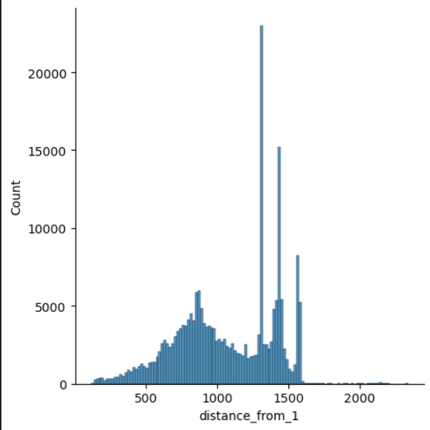
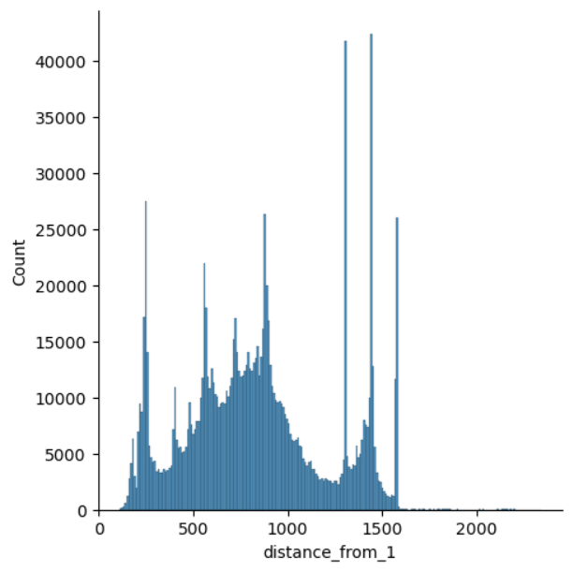
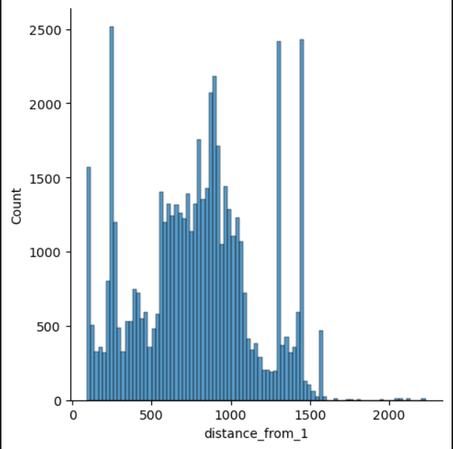
Creating Recommendations for Fleet 1
Euclidean-Dist ( NTP , row-i) for each row of fleet considering NTP’s of fleet
Similarity based on NTP’s
Fleet 2
Fleet 2
Fleet 3
Fleet 3
Fleet.mean() for Non-Trimmable parameters for Fleet 1
Dist(NTP , fleet_i)
NTP’s
Dist(NTP , fleet_i)
Fleet4
Fleet 4
Dist(NTP , fleet_i)
Overwriting the NTP’s of fleets with fleet1
Fleet 2
NTP’s
TPs
Recommendation from each fleet on Trimmable params
Fleet 3
Model i
Y^
NTP’s
TPs
NTP’s
TPs
Fleet 4
NTP’s
TPs
From the similarity distances , took the distances < 250 , and from that top 500 observations/rows.
Updated for each fleet NTP, value of Fleet 1 NTP’s values

